Slide 1
Testing of Hypothesis (t-test for a mean)
Osama Bin Ajaz
Lecturer at FAST-NUCES, Main Campus, Karachi

Slide 2
T-test for Means (μ)
When σ is unknown and n < 30, then z-test is inappropriate for testing of hypotheses involving means. Then t-test is used.
t-test is used when σ is unknown, n < 30, population is normally or approximately normally distributed.

Slide 3
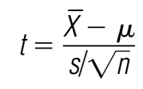
The formula for t-statistic is:
with degrees of freedom d. f. = n – 1

Slide 4
Similarity B/w t & Std. Normal Distribution
It is bell-shaped.
It is symmetrical about mean.
Mean = Median = Mode = 0
The curve never touches x-axis.

Slide 5
Difference B/w t-distribution & Std. Normal distribution
The variance is greater than 1. [var = υ/(υ-1); υ ≥ 3]
The t-distribution is less peaked than normal distribution.
The t-distribution has greater dispersion than normal distribution with heavier tails.
The t distribution is a family of curves based on the degrees of freedom, which is a number related to sample size.
As the sample size increases, the t distribution approaches the normal distribution.

Slide 6
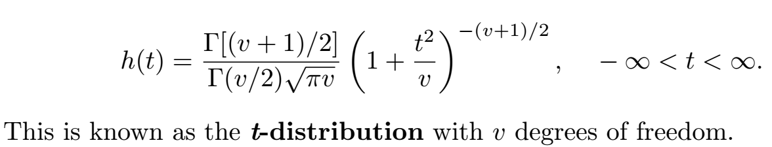
PDF of t-Distribution

Slide 7
Example # 01
A job placement director claims that the average starting salary for nurses is $24,000. A sample of 10 nurses has a mean of $23,450 and a standard deviation of $400. Is there enough evidence to reject the director’s claim at α 0.05?

Slide 8
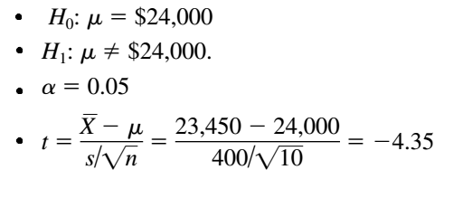
Example # 01 (Solution)
The critical values are +2.262 and -2.262 for α = 0.05 and υ = 9. (See Figure – I on next slide).
Reject the null hypothesis, since -4.35 < -2.262
There is enough evidence to reject the claim that the starting salary of nurses is $24,000.

Slide 9
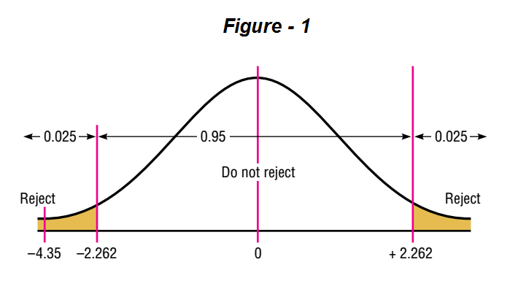

Slide 10
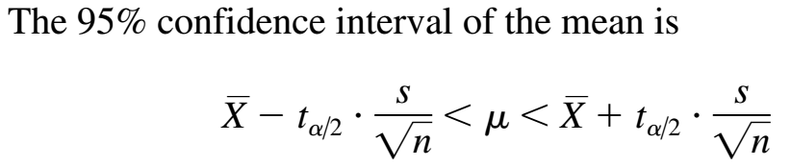

Slide 11
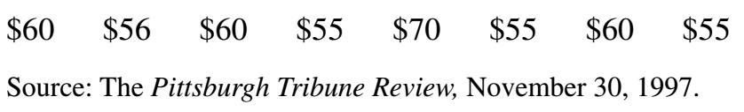
Example # 02
An educator claims that the average salary of substitute teachers in school districts in Allegheny County, Pennsylvania, is less than $60 per day. A random sample of 8 school districts is selected, and the daily salaries are shown. Is there enough evidence to support the educator’s claim at α 0.10?

Slide 12

Example # 03
A new laboratory technician read a report that the number of students using the computer laboratory per hour was 16. To test this hypothesis, he selected a day at random and kept track of the number of students who used the lab over an eight-hour period. The results were as follows:
At α=0.05, test the claim that the average is actually 16.

Slide 13
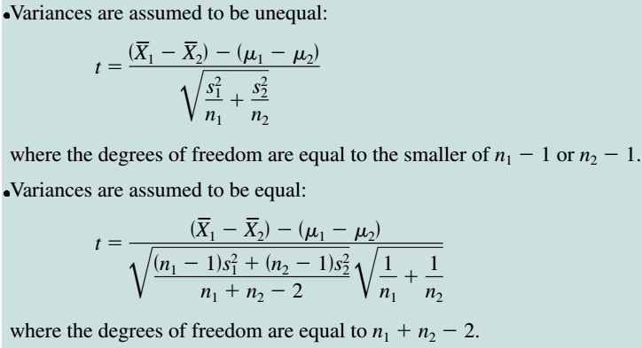
Testing Difference b/w two Means

Slide 14
Example # 04
The average size of a farm in Indiana County, Pennsylvania, is 191 acres. The average size of a farm in Greene County, Pennsylvania, is 199 acres. Assume the data were obtained from two samples with standard deviations of 38 acres and 12 acres, respectively, and sample sizes of 8 and 10, respectively. Can it be concluded at α= 0.05 that the average size of the farms in the two counties is different? Assume the populations are normally distributed and variance are unequal.

Slide 15

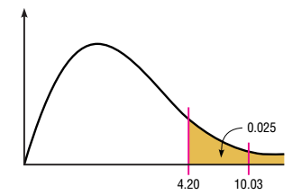
Example 04 (contd.)
Testing equality of population variances.
Critical value for F-test is 4.20
Reject the null hypothesis since 10.03 falls in the critical region.

Slide 16
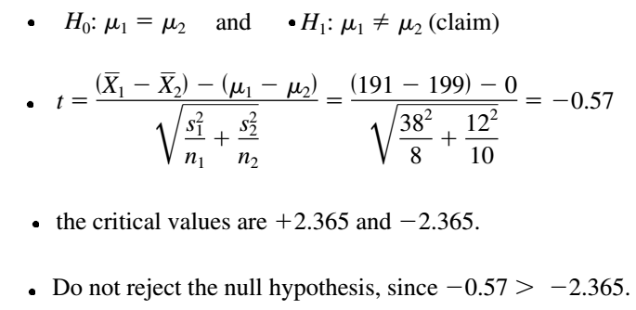
Example # 04 (Solution)

Slide 17
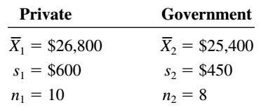
Example # 05
A researcher wishes to determine whether the salaries of professional nurses employed by private hospitals are higher than those of nurses employed by government-owned hospitals. She selects a sample of nurses from each type of hospital and calculates the means and standard deviations of their salaries. At α= 0.01, can she conclude that the private hospitals pay more than the government hospitals? Assume that the populations are approximately normally distributed and variance are equal.

Slide 18

Example 05 (contd.)
Testing equality:
Decision: Do not reject Ho

Slide 19
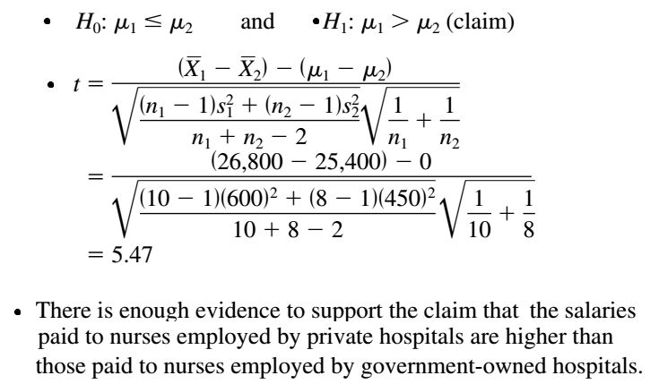
Example # 06 (Solution)

Slide 20
t-test for paired observations
In the previous slides, the t test was used to compare two sample means when the samples were independent.
Now we used t-test for dependent/paired samples.
Samples are considered to be dependent Samples when the subjects are paired or matched in some way.
Paired samples, Related samples and dependent samples are synonyms to each other.
t-test for paired observations

Slide 21
Examples of dependent samples
A medical specialist may want to see whether a new counseling program will help subjects lose weight. Therefore, the pre-weights of the subjects will be compared with the post-weights.
A researcher may want to design a SAT preparation course to help students raise their test scores the second time they take the SAT exam.
Blood pressure before and after computer programming.
t-test for paired observations

Slide 22
Note of caution using paired t-test
When subjects are matched according to one variable, the matching process does not eliminate the influence of other variables
t-test for paired observations

Slide 23
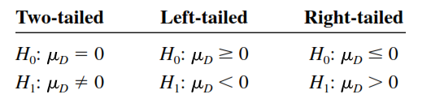


Steps involving paired t-test
When the samples are dependent, a special t test for dependent means is used. This test employs the difference in values of the matched pairs. The hypotheses are as follows:
Calculate the differences of the values of the paired data.
Calculate t-statistics using formula:
t-test for paired observations

Slide 24
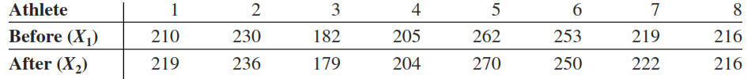
Example # 07
A physical education director claims by taking a special vitamin, a weight lifter can increase his strength. Eight athletes are selected and given a test of strength, using the standard bench press. After two weeks of regular training, supplemented with the vitamin, they are tested again. Test the effectiveness of the vitamin regimen at ἀ = 0.05. Each value in the data that follow represents the maximum number of pounds the athlete can bench press. Assume that the variable is approximately normally distributed.
t-test for paired observations

Slide 25
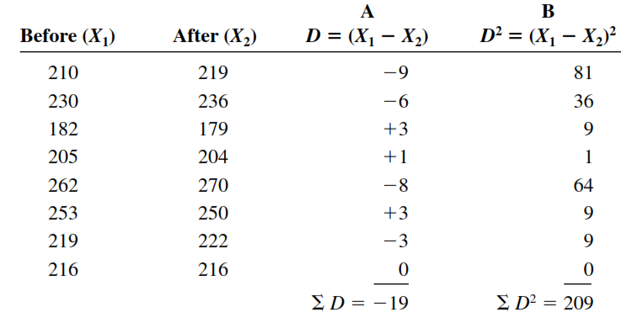
Solution (Example 07)
t-test for paired observations

Slide 26


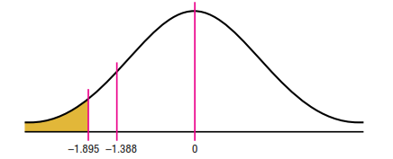
Solution (Example 07, contd.)
The decision is not to reject the null hypothesis , since
t-test for paired observations

Slide 27

Example # 08
A dietitian wishes to see if a person’s cholesterol level will change if the diet is supplemented by a certain mineral. Six subjects were pretested and then took the mineral supplement for a six-week period. The results are shown in the table. (Cholesterol level is Measured in milligrams per deciliter.) Can it be concluded that the cholesterol level has been changed at alpha = 0.10? Assume the variable is approximately normally distributed.

Slide 28
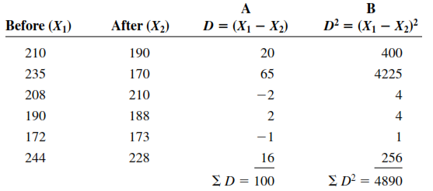

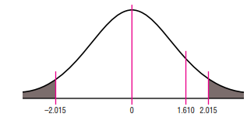
Solution (example 08)
There is not enough evidence to support the claim that the mineral changes a person’s cholesterol level.

Slide 29
Practice Questions
Q1) A composition teacher wishes to see whether a new grammar program will reduce the number of grammatical errors her students make when writing a two-page essay. The data are shown here. At alpha = 0.025, can it be concluded that the number of errors has been reduced?

Slide 30



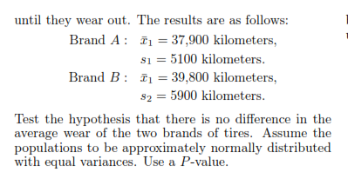
Q2)
Q3)

Slide 31
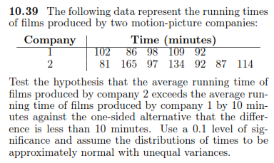
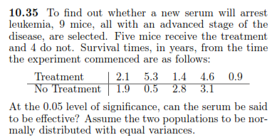
Q4)
Q5)

